Slide 1
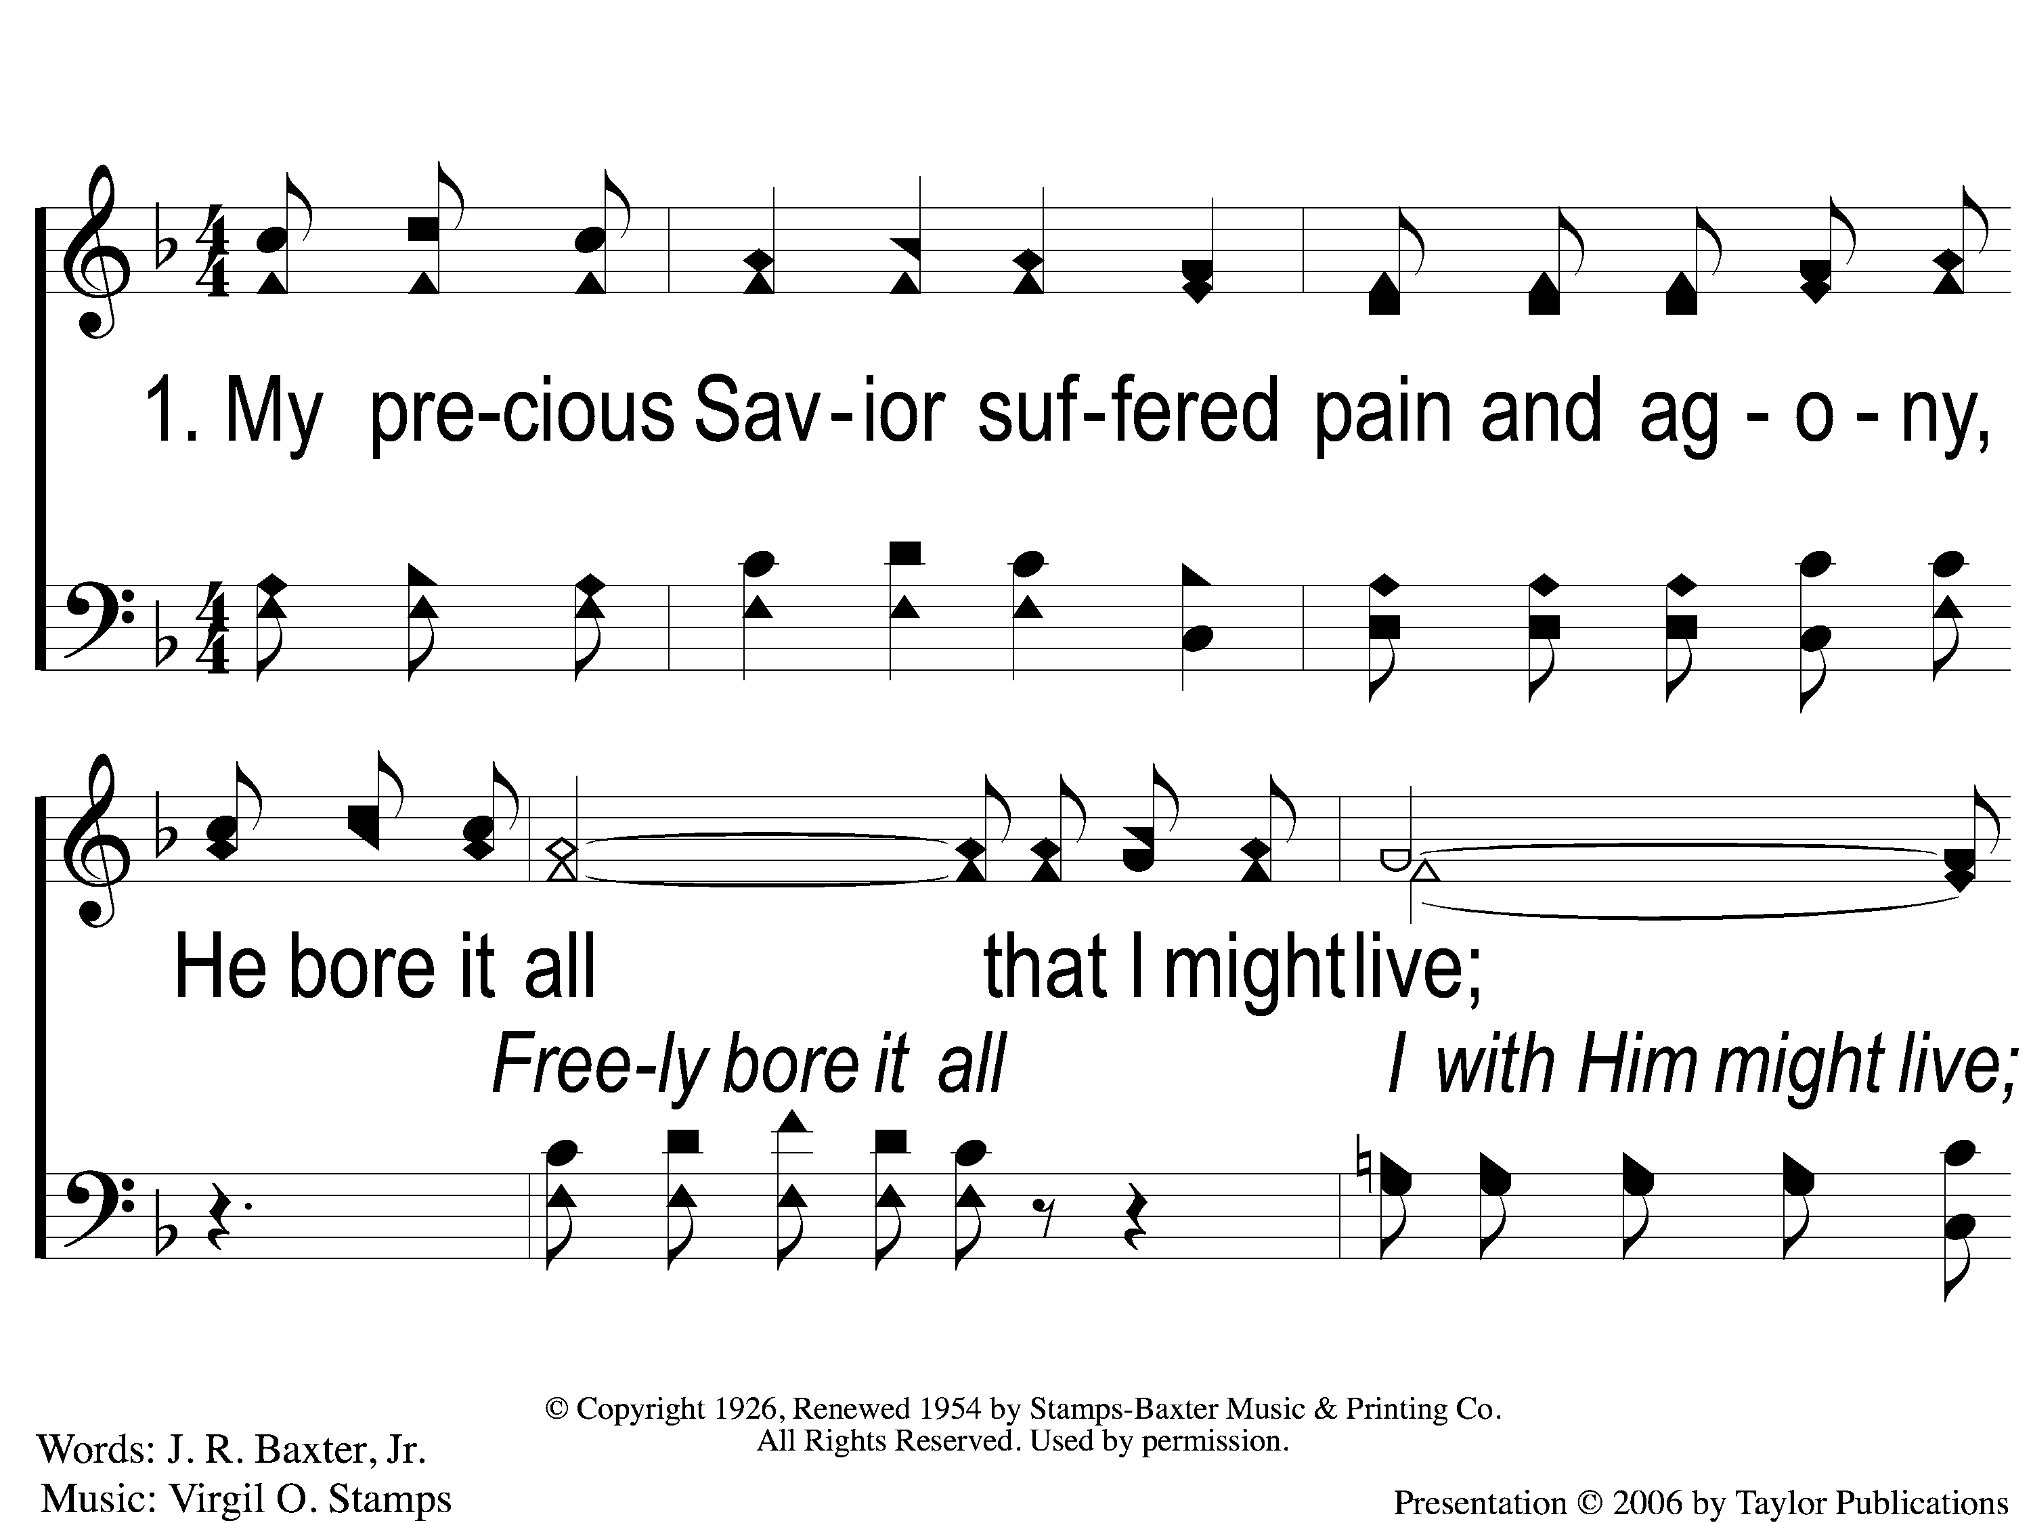
1-1 He Bore It All
He Bore It All
158

Slide 2
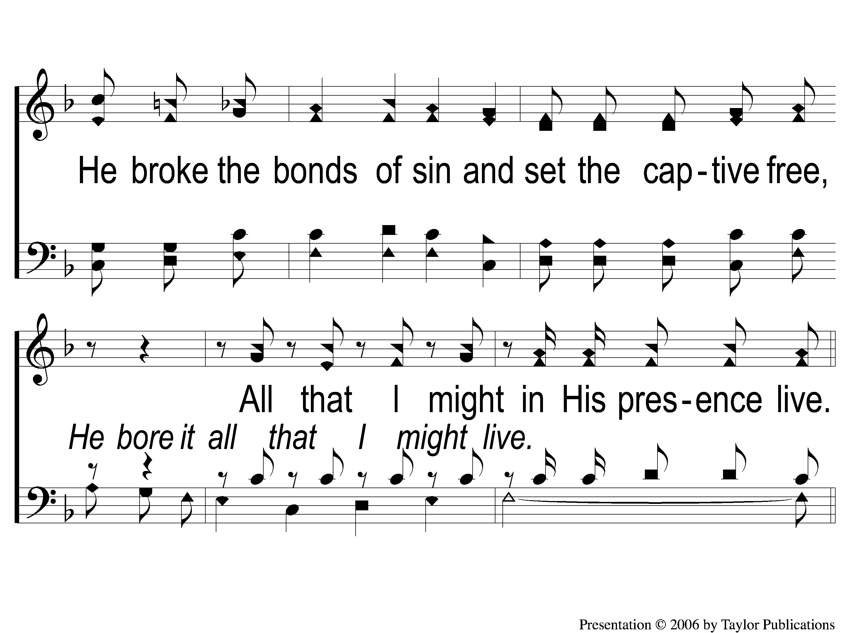
1-2 He Bore It All
He Bore It All
158

Slide 3
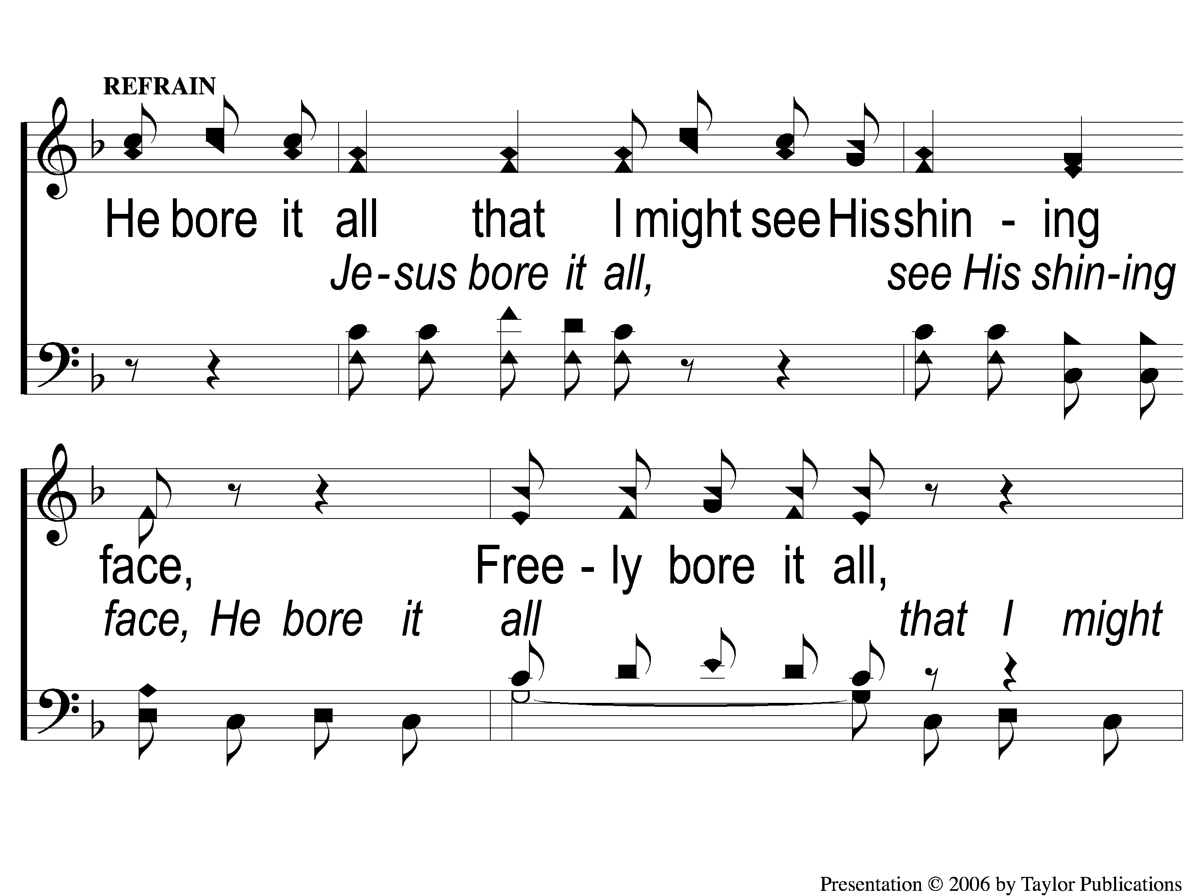
C-1 He Bore It All
He Bore It All
158

Slide 4
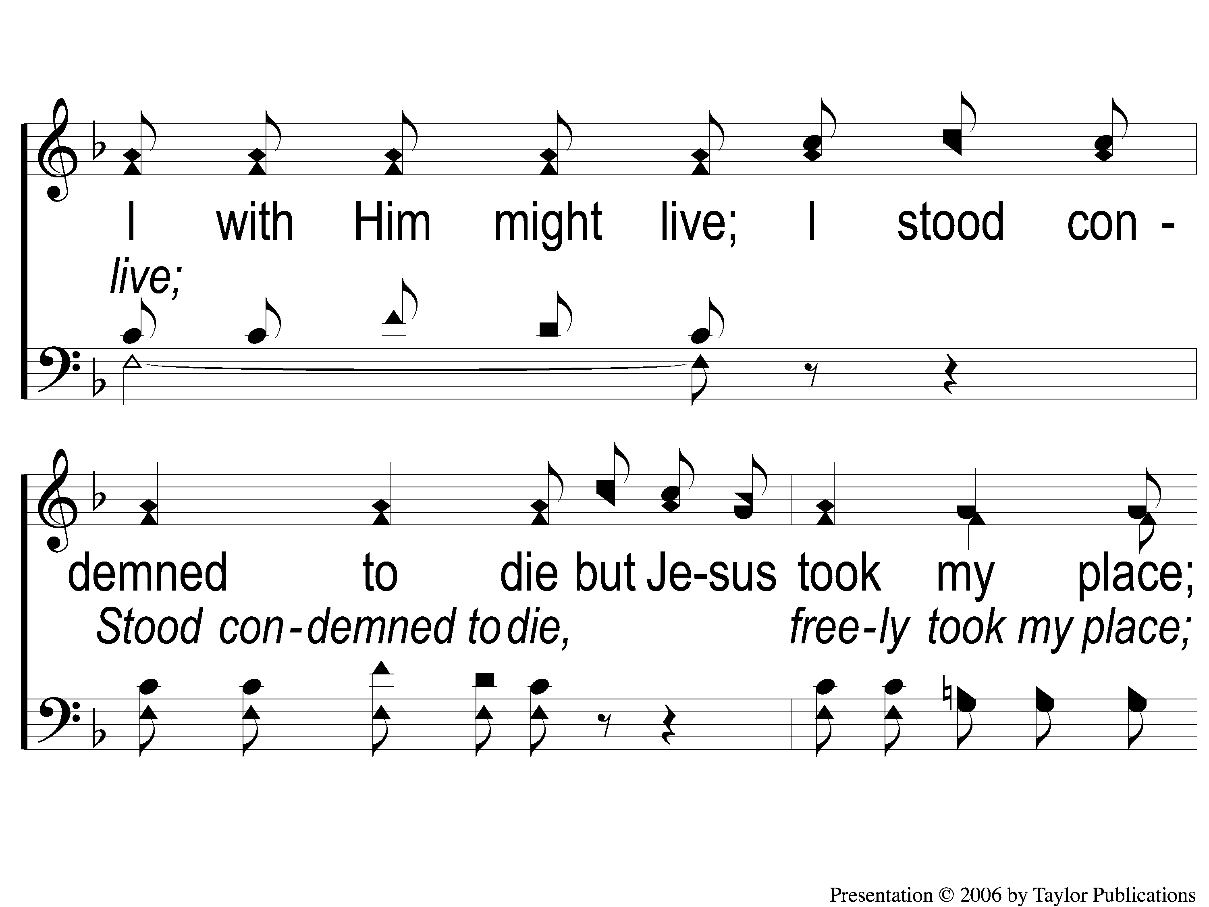
C-2 He Bore It All
He Bore It All
158

Slide 5
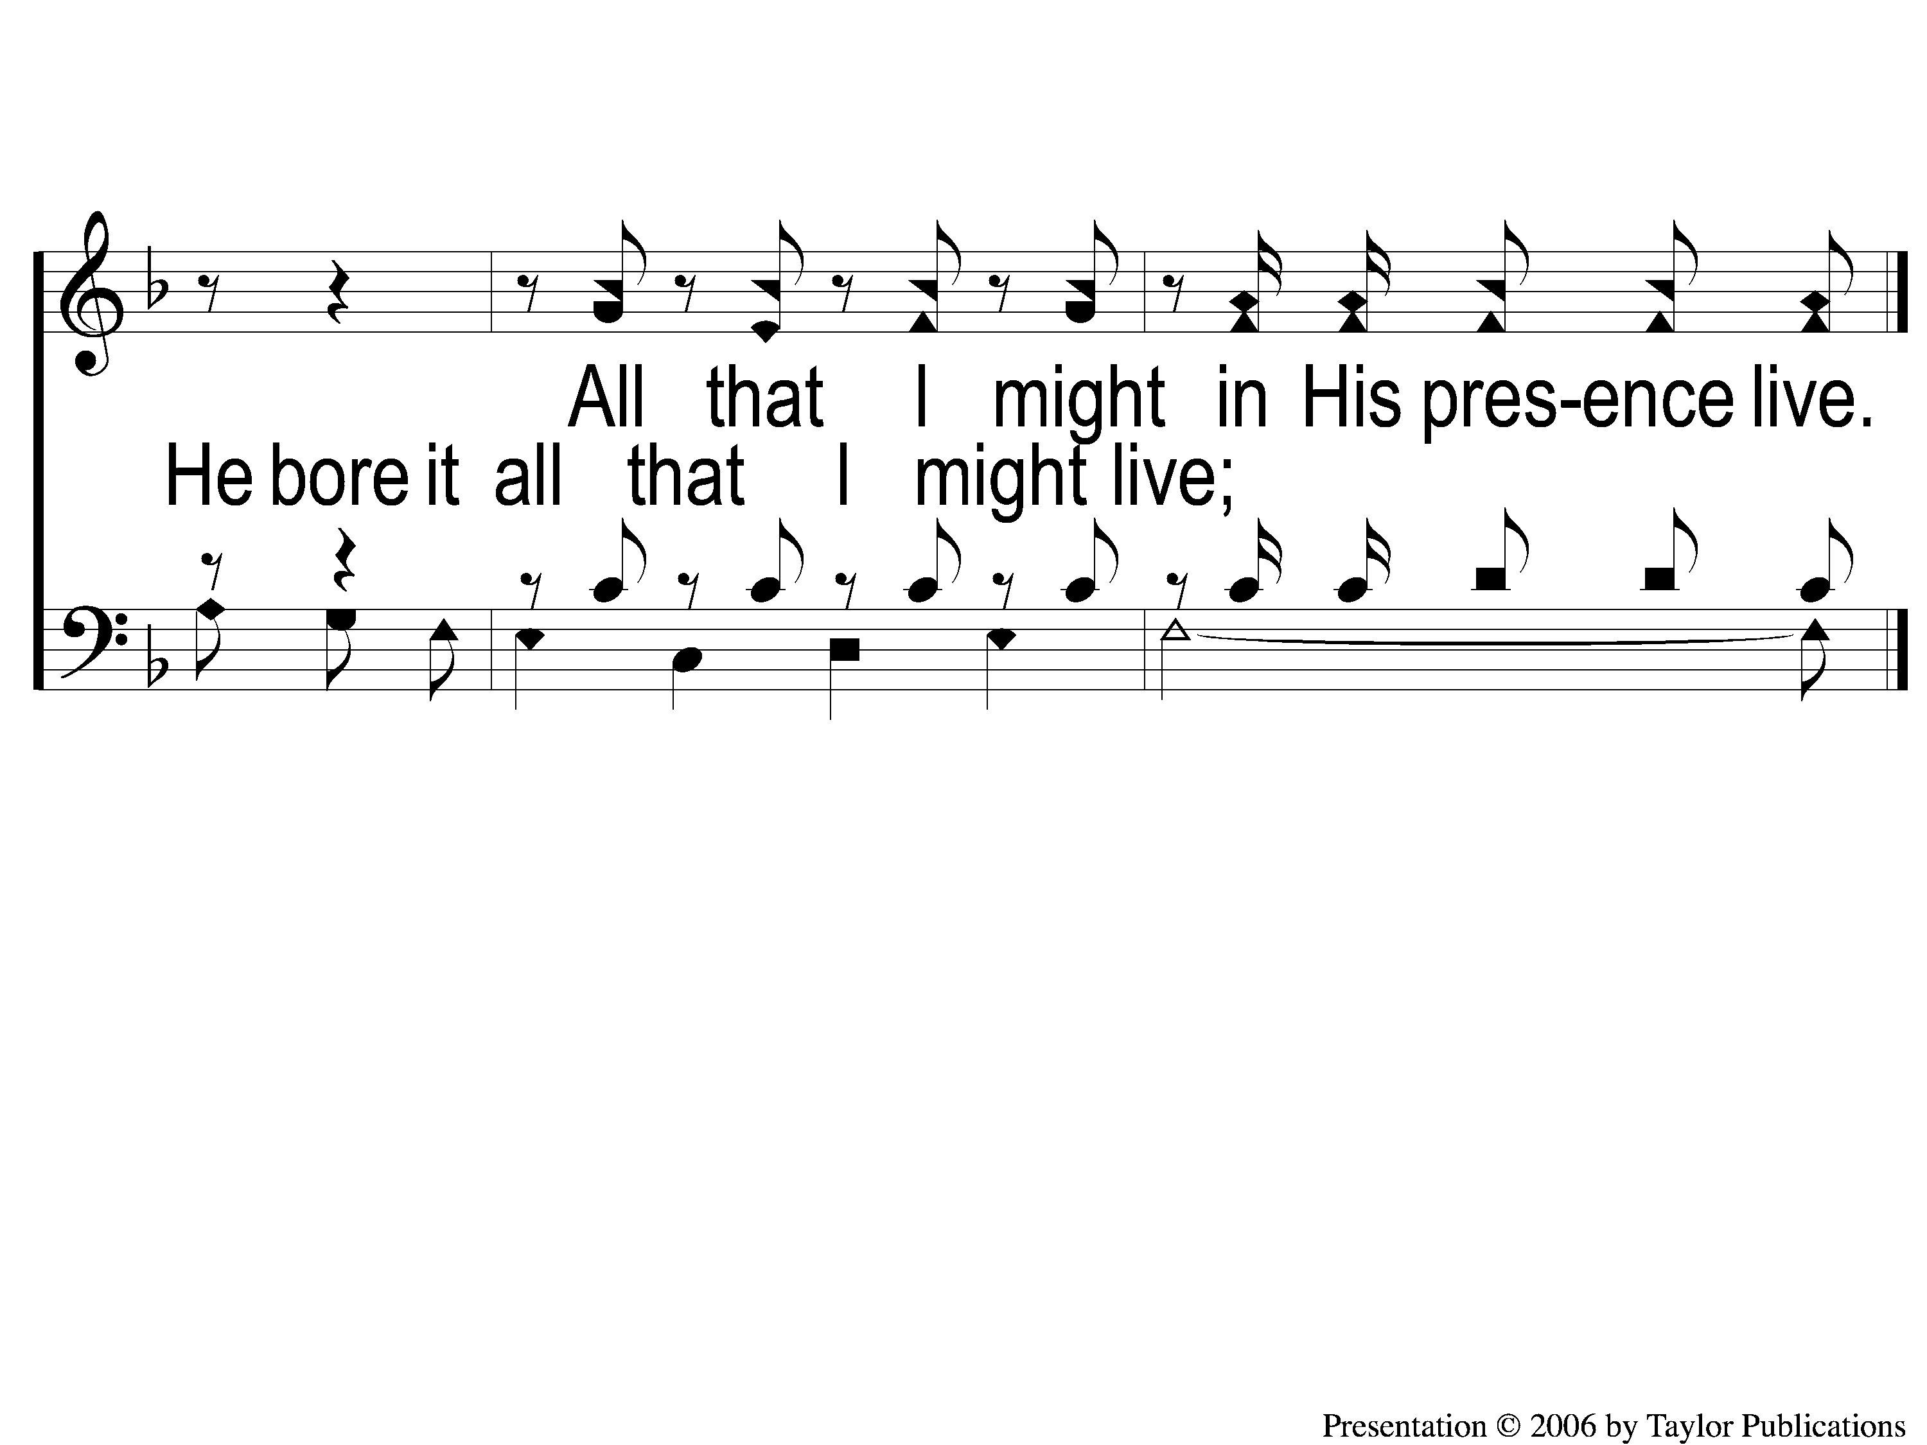
C-3 He Bore It All
He Bore It All
158

Slide 6
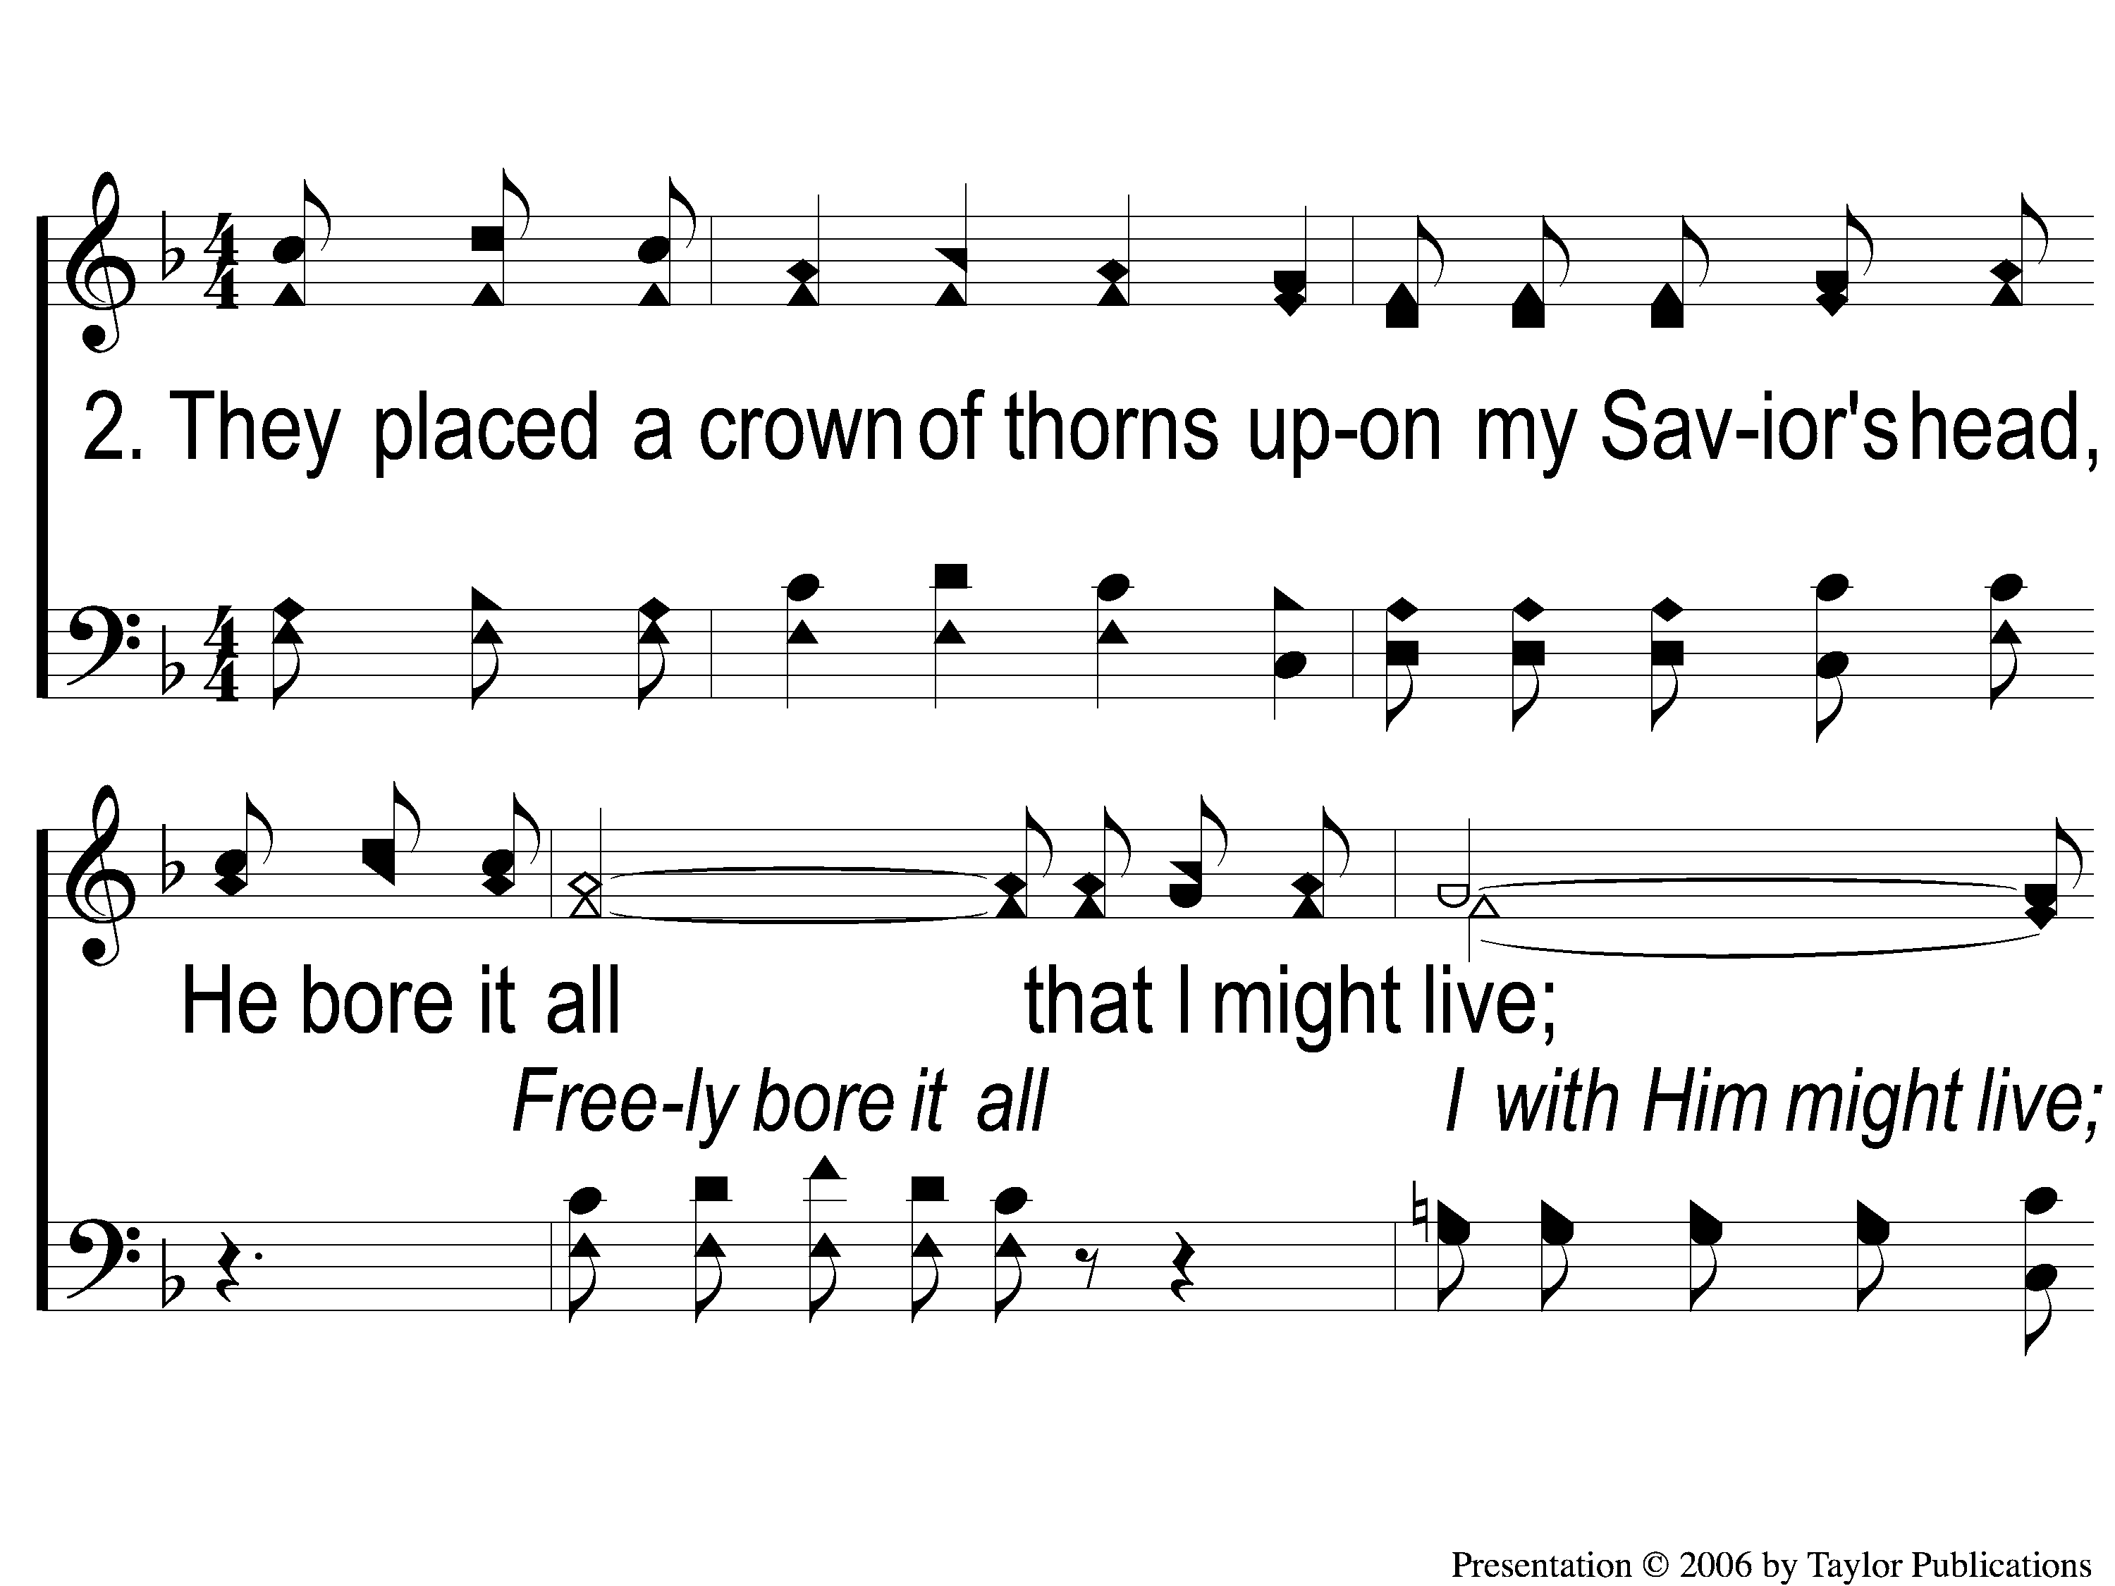
2-1 He Bore It All
He Bore It All
158

Slide 7
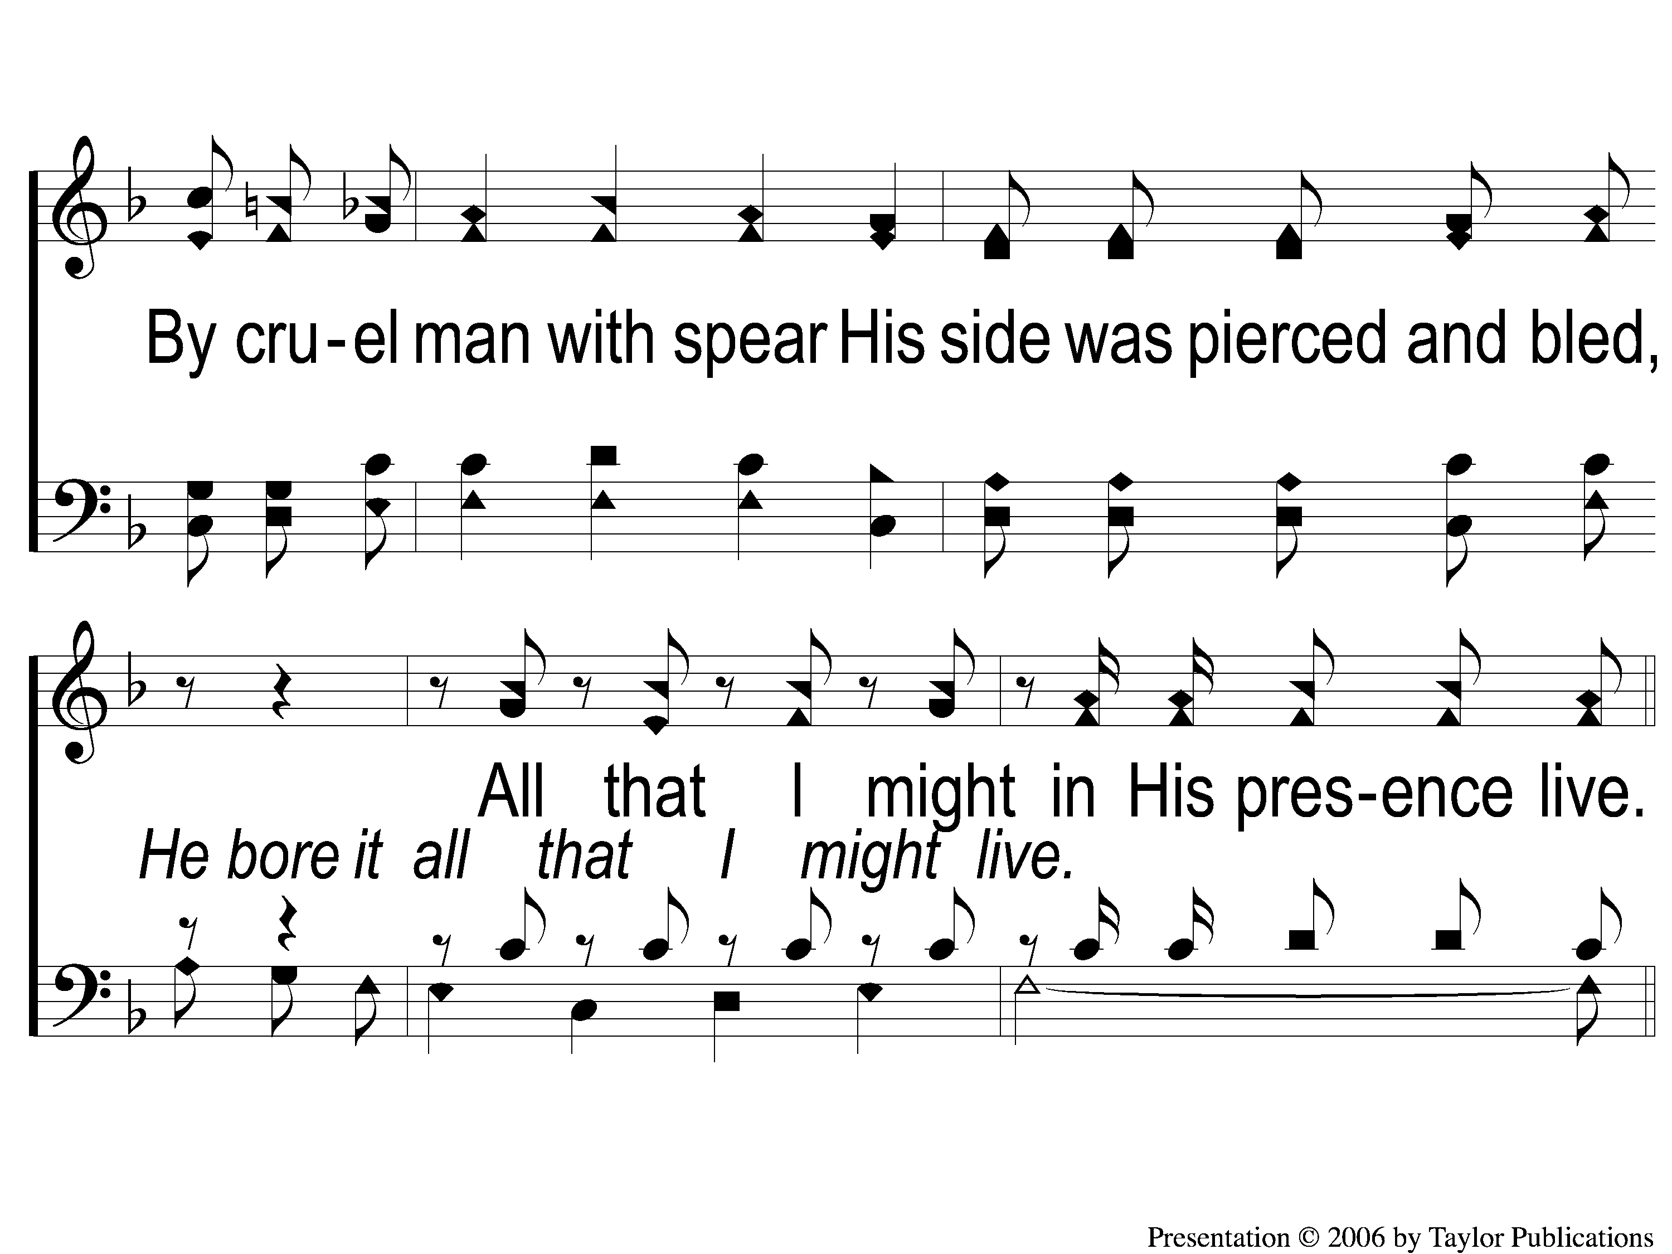
2-2 He Bore It All
He Bore It All
158

Slide 8
C-1 He Bore It All
He Bore It All
158

Slide 9
C-2 He Bore It All
He Bore It All
158

Slide 10
C-3 He Bore It All
He Bore It All
158

Slide 11
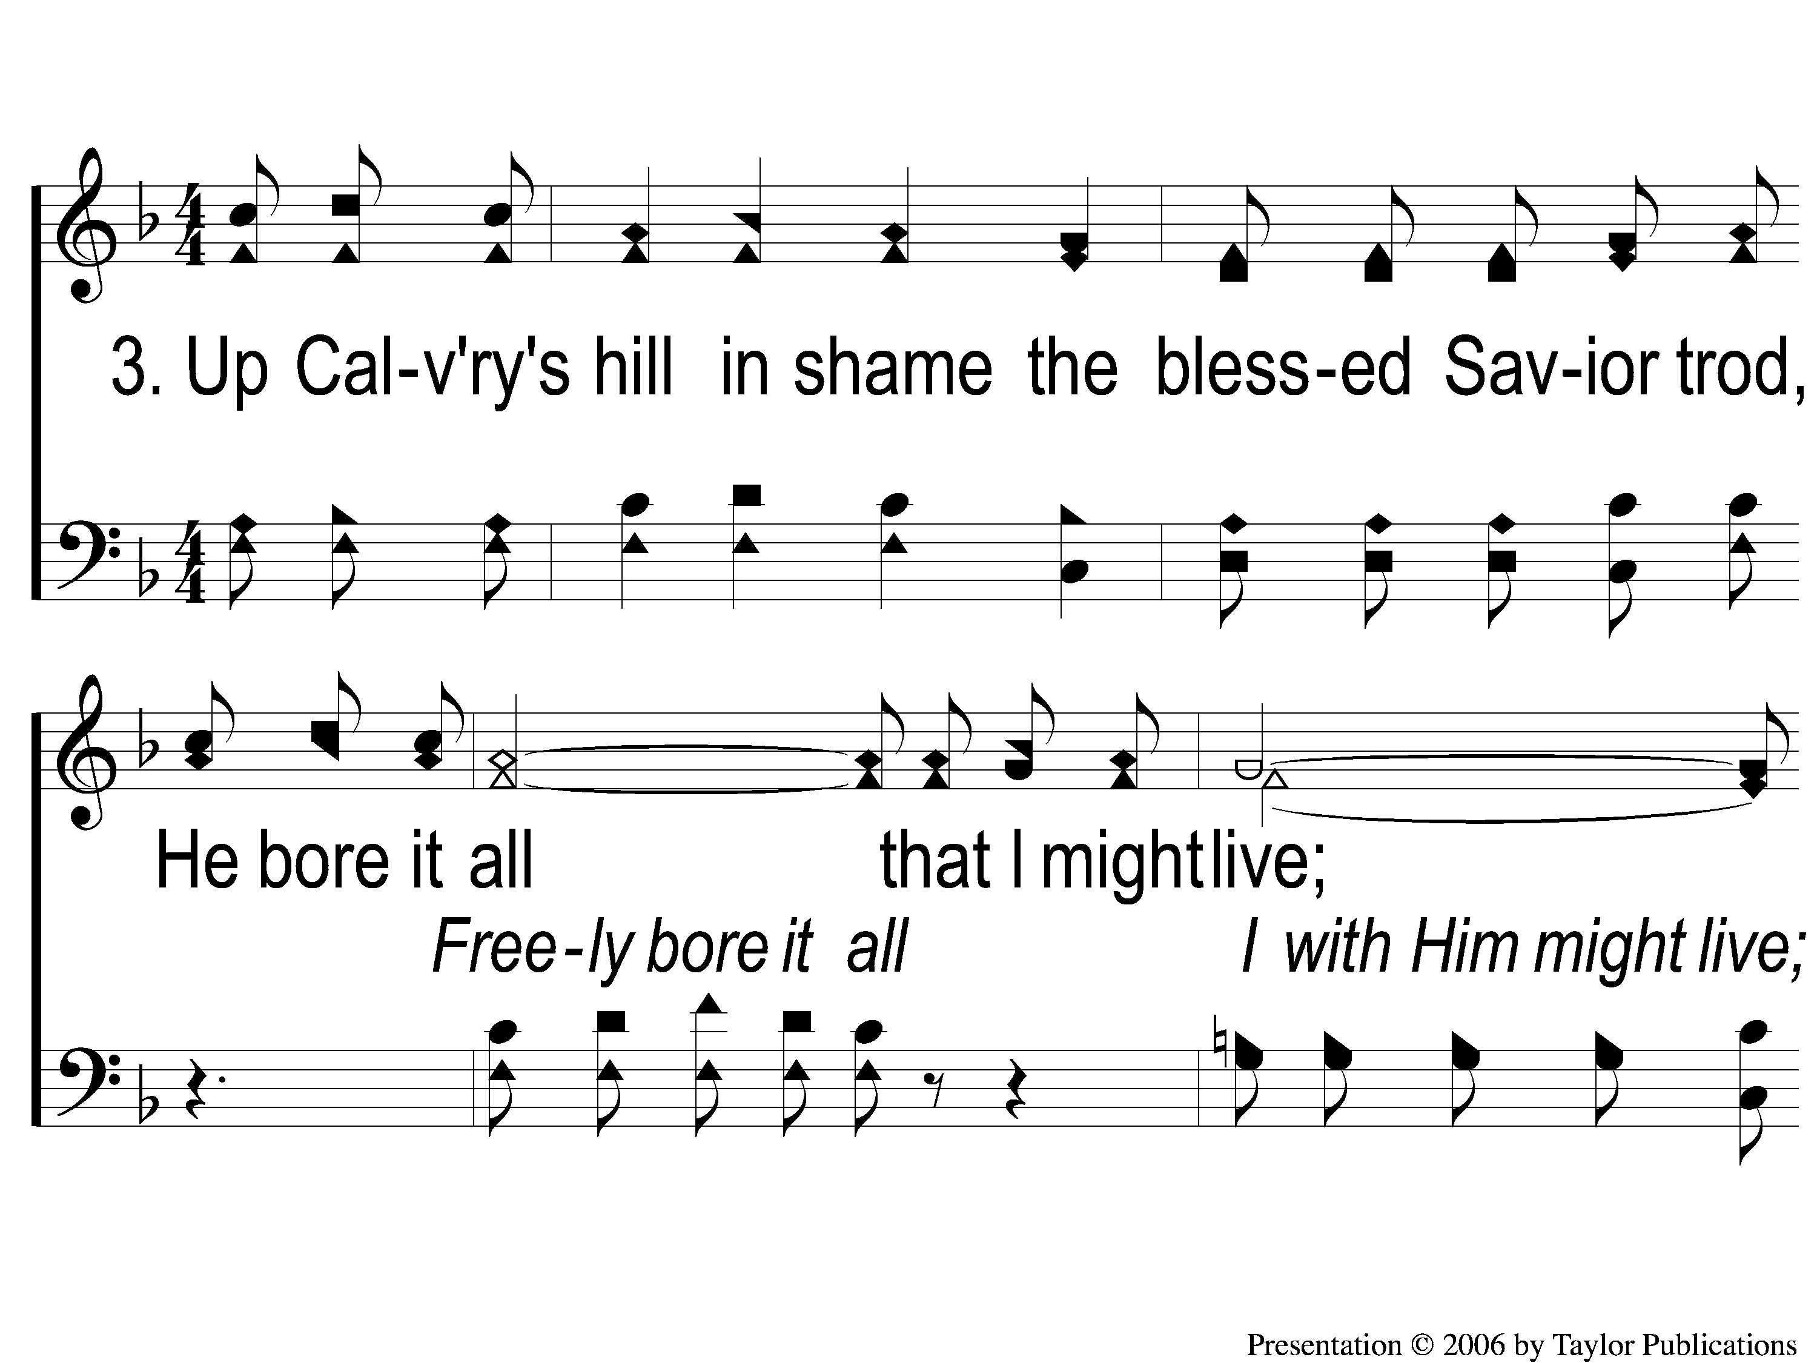
3-1 He Bore It All
He Bore It All
158

Slide 12
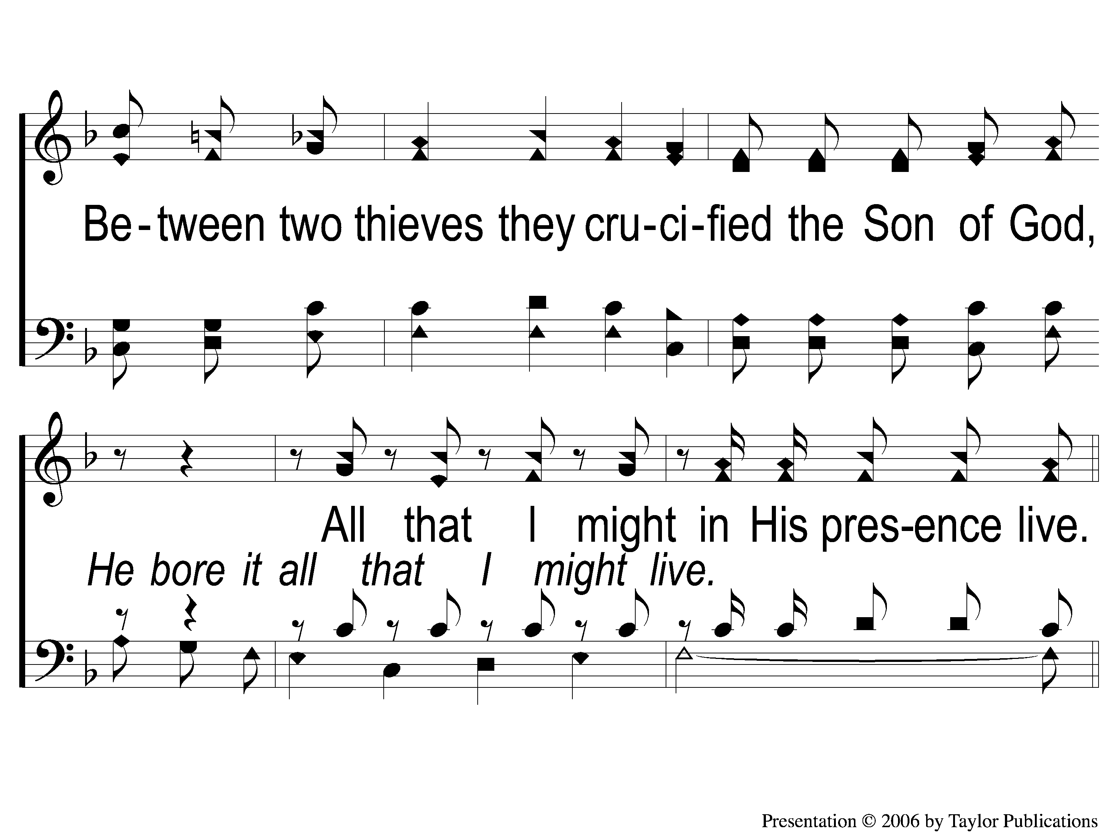
3-2 He Bore It All
He Bore It All
158

Slide 13
C-1 He Bore It All
He Bore It All
158

Slide 14
C-2 He Bore It All
He Bore It All
158

Slide 15
C-3 He Bore It All
He Bore It All
158

